Slide 1

Design project of RCE Sask website
Submitted by
Tonmoy Sarker
Rezvan Shokrani
Bipin Suram

Slide 2
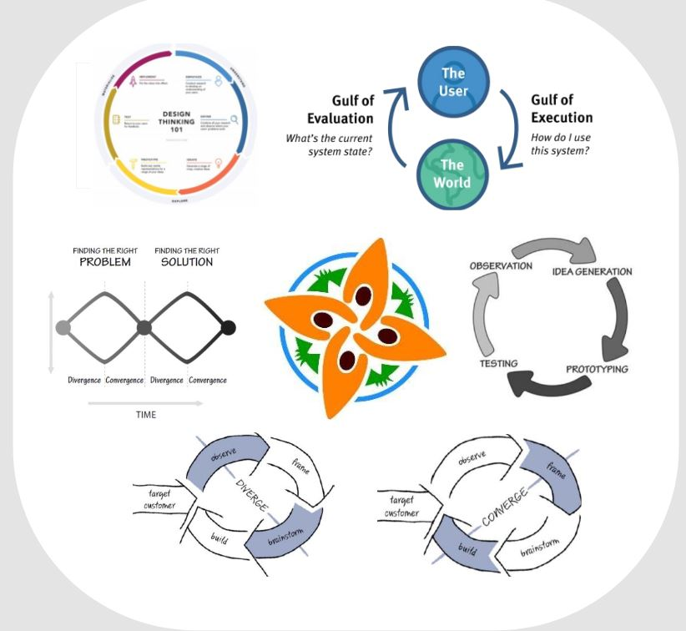
Outline
Abstract
Background
Problem
Suggested solution
Results
Demo
Summary

Slide 3
Abstract
Focused on designing the professional high-fidelity prototype of the RCE(Regional Centre of Expertise) Saskatchewan website
Current website is unorganized with most of the content not shared on the web pages and not linked with the main page
We have tried to organize all the content that the website has and our designs mainly strives for ‘Customer Delight’

Slide 4
Background
RCE is the global platform for sustainable development. It focuses on the betterment of the human lives and at the same time keeping the environment unharmed
RCE’s goal is to provide transformative education to promote sustainable lifestyle and livelihoods in the region
The design of the website plays a major role in gaining the attention of the users and provoke a thought to join RCE or donate
Can the website be recreated in a way to attract the users?

Slide 5
Problems
The major issues with the current website are: - Unorganized - Poor content management - Do not provide customized user profile for members - No links to connect to social media other than twitter - Unappealing and less user friendly - No donate option - Lack good customer experience

Slide 6
Suggested Solution
Our designs mainly addressed the content of the website and shown them in an easy and organized manner
Navigation through different contents is made easy by our left vertical menu on homepage
Registered members can manage their own content
We have added few colors to make the website eye catchy
Our photo/video gallery will help to enhance the usability
Donate option is subdivided into ‘Donate service’ and ‘Donate money’ where users can not only donate in monetary terms but also the service

Slide 7
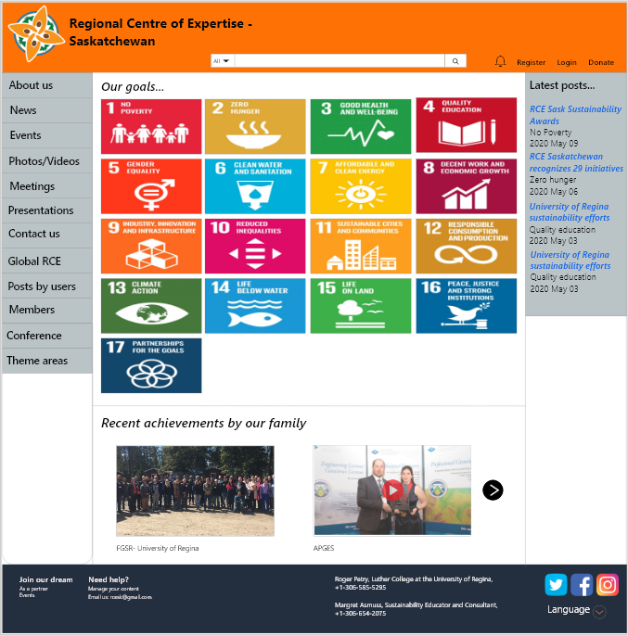
Results
Following screenshots show few highlights of our design:
Homepage - Can navigate to almost everywhere from here
Highlighted the 17 goals of RCE and also recent achievements by members
Provided the direct links to the social media
Donate option on the top right

Slide 8


Results Cont..
Universal website search will save lot of time as users can search any article, members etc directly
Users can see the latest notifications on any news or events. Donate option is placed beside register or login to make it noticeable
Users can connect to the three provided social media sites with one click. Also they have the option to change the language of the website to French or English

Slide 9
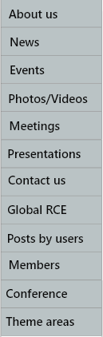
Results Cont..
Most of the users will be interested in photos and videos rather than reading, so we have provided photo/video gallery
Can connect to the Global RCE website with a single click
As different RCE’s are formed to address different issues, we have included the ‘Theme areas’ function on this menu

Slide 10
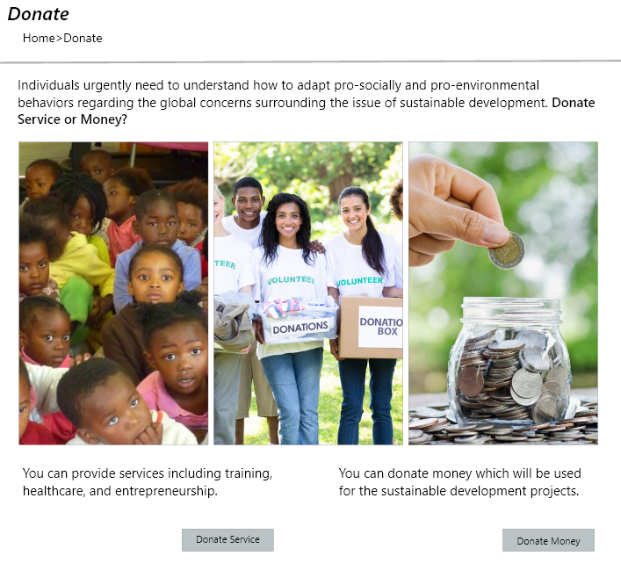
Results Cont..
Being aware of financial constraints of few users, we have new option for not only donating the money but also service
The users who cannot donate the money will still be able to provide their valuable service to RCE and feel as a part of great work

Slide 11
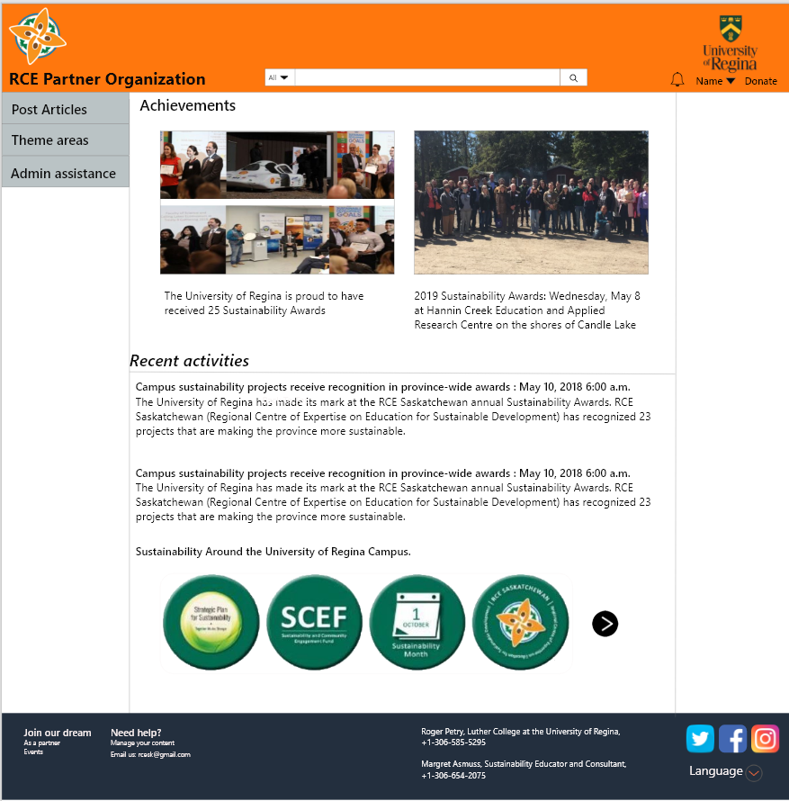
Results Cont..
Provided option for registered members to login to their own profile and manage the content on their profile
Members can post articles, achievements in the field of sustainable development
Can have their own logo at the top right corner

Slide 12
Demo!

Slide 13
Summary
We believe that our design patterns will appeal to maximum set of people and also help to increase the user base of the website
The same design can also be replicated for mobile users
Going forward we can try to develop the real website based on our prototype if permitted.

Slide 14
References
RCE Saskatchewan Website.Retrieved from: https://www.saskrce.ca/
RCE Saskatchewan’s Official Facebook page. Retrieved from: https://www.facebook.com/search/top/?q=rce%20saskatchewan&epa=SEARCH_BOX
RCE Saskatchewan’s Official Twitter page. Retrieved from: https://twitter.com/SaskRCE

Slide 15
Thank You!!!

